Slide 1
Reinvent Yourself for the New Workplace
Rosemarie Christopher
President & CEO
Notes:
Introduction of MEIRxRS and RC’s experience in recruiting and placing entry level professionals.
Introduce the entire presentation starting from looking for a job, applying for one and keeping it.

Slide 2
Look – Apply – Keep
Where to look for a job
How to apply for a job
Learn to keep a job
Notes:
Job hunting trends-it’s who you know, networking through the social media
New application processes-all electronic
Surviving the new workplace

Slide 3
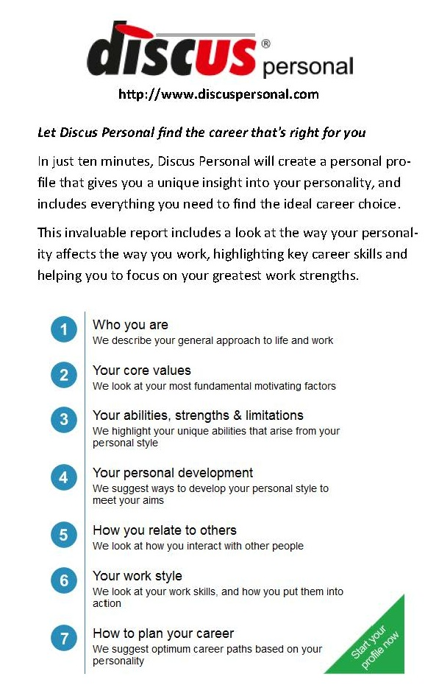
Work Personality Profile
Core values
Abilities, strengths, limitations
Communication style
Personal style
Work style
Notes:
About You describes your general approach to life and work.
Your Core Values looks at your most fundamental motivating factors.
Abilities, Strengths, Limitations highlights the unique abilities that arise from your personal style.
Personal Development suggests ways to develop your personal style to meet your aims.
Relating to Other People talks about how you interact with other people.
Your Work Style looks at your work skills, and how you put them into action.
Helps you plan your optimum career paths based on your personality.

Slide 4
Where are the jobs?
Online and Print Media
Job Boards
Journals, Newspapers
Network
Social Media
Professional Associations
Notes:
- Traditional: Print media & in person networking
- Non-Traditional: online such as job boards & social media
- Virtual Networks: ask for introductions/referrals (market yourself)
Facebook
LinkedIn
Plaxo-gather information, ask for referrals/introductions, market yourself
Professional: AMCP, ISPOR, RAPS, ASQ, ISPE
Trade associations: SME, IEEE, ISPE
Twitter
- Professional Networks: active participation, membership, professional development
NEXT SLIDE: GET YOUR FOOT IN THE DOOR

Slide 5
Apply for the Job
Research Companies
Find Job Openings
Make Sure you are Qualified
Find the Hiring Authority
Secure Position Description
Prepare an Executive Summary
E-mail to the Hiring Authority ONLY

Slide 6
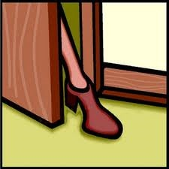
Get your foot in the door
30-Second Commercial
Executive Summary
Resume
Power Words
Interviewing Tips
Notes:
Elevator speech-30 second commercial handout
Cover letter-executive summary handout
Resume template/sample handouts

Slide 7
Resume Template
Heading
Contact information
Body
Summary of Skills
Employment History
Education/Certifications
Professional Associations/Affiliations
Notes:
One page resume template handout
Sample resume handout

Slide 8
Get the job
Interview Preparation
Before
During
After
Interactive Interview Questions
Notes:
Do homework-research company, read and understand the job description and what the company is looking for; name/background of interviewer-social network research; directions/parking to the interview; practice answering questions
Presentation-dress, professionalism, manners, handshake, breaking the ice, questions to ask that shows that you share the company’s goals
Tips for interviewing at XYZ Company handout
Thank you note/follow up letter/email
INTERACTIVE INTERVIEW QUESTIONS

Slide 9
Sample interview questions
Why are you interested in this job? Why are you interested in working for this company?
What type of training, qualification or experience do you have for this job?
What do you consider to be your greatest strengths and weaknesses?
How are you going to make a contribution to this company?
How would you describe your leadership skills?
Why are you successful?
Why should I hire you?
Notes:
More sample interview questions handout

Slide 10
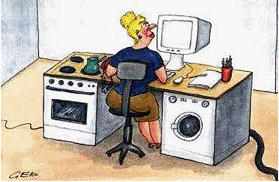
Keep the job
Surviving in the new workplace
“Fitting in” a multi-generation workforce
Knowing how to evaluate your professional growth
Notes:
Surviving in the workplace: Evolution of work; Multigenerational workforce characteristics

Slide 11
Keep the JOB ?

Slide 12
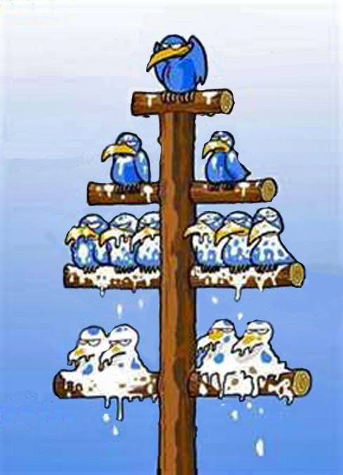
The Current situation in the Society and in the Workplace:
No!
Top Down Information Flow
Directive Leadership Style
Command & Control
manager
Executives
Departments
The Rest
Notes:
Influencer Leadership does NOT necessarily mean a TITLE in this “Gen Flux” world
‘Generation Flux’, (Fast Company 02-2012),
People must come to terms with diminishing personal power
Organizations are ‘flatter’; demise of certain middle management roles
Work is outsourced; nationally and globally
People work in matrix structured organizations
Management is by means of the use of the weapons of ‘team destruction’ more often than NOT
Leadership is simply not there:
Influencer Leadership – A new paradigm for Knowledge Workers

Slide 13
The new evolution of work…
Face to Face Meeting-Teleconference-Webinar
Paperless office
PC-Laptops-Tablets
Telephone-Mobile Phone-Smartphone
Avatars
Server-Cloud Computing
Snail Mail-Email-Chat-Instant Message-Text
Social Networking
Podcast
Virtual World/Workplace
Dial Up-Broadband-WiFi-DSL-Cable-TI-Fiber Optic
Listserv-Message Board
Widgets-Apps
Website-Blogging/Micro-Blogging
RSS Feed

Slide 15
Multi-Generational Workforce
Gen X / Gen Y
Life is comes first-work to live
Follows rules that work or make new rules
Equality and respect given only when earned; loyal to relationships
Talent=promotion; high expectations
No defined work hours; clock out when work is done
Dress the part when necessary-casual Fridays/business casual attire
Expects organization to change to meet their needs
Mature/Boomers
Work is priority-live to work
Follows rules no matter what
Boss deserves respect; loyal to employer
Seniority = promotion; high achievers
9-5 work hours and overtime expected
Dress the part at all times-formal business attire
Will change to meet the needs of the organization
Similarities among the generations:
Dependable
Reliable
Dedicated
Conscientious
Adaptable
Achiever
Motivated
Responsible
Accountable
Hard Worker

Slide 16
YES! A collaborative culture built on Influence leadership
Notes:
Influencer Leadership does NOT necessarily mean a TITLE in this “Gen Flux” world
‘Generation Flux’, (Fast Company 02-2012),
Realization we are all in this together: ‘com panis’ company – ‘bread sharers’; dependent on; accountable to (Exercise: Who are our bread sharers? )
Appreciation: Similarities & Differences Values vs Styles (Exercise: from the work personality profile); Focus is on the similarities-values; not the differences -styles
Conflict Resolution: tension is not all bad or all good; it just IS ever present (developing the ability to listen carefully; to acknowledge differences does not mean one has to ‘buy in’ ; just mirror or mimic a style to negotiate a result
’

Slide 17
WHY: MS Reg Sci or Quality ?
Influencer leadership
Strategy
Apprenticeship/Internships/Mentoring
Motivation
Trust
Notes:
Influencer leadership: getting peers; direct reports and even senior management to do the ‘right thing’ or the things they don’t want to do with ease and polish
a requirement of every knowledge worker in a ‘flat’ organization and virtual world/workplace
Strategic; Give clear direction; have a plan; communicate it well
Mentor/Reverse Mentor – the right person for the right job; train and be trainable
Motivate self and others – knowledge workers are looking to make a difference
Build trust- The smooth running of a Department or a Company requires close collaboration; This is not going to happen unless there is a trust bond- built on integrity; ethics and collaboration
People don’t care until they can trust and KNOW that you care

Slide 18
Moving From MANAGER to INFLUENCER LEADER
Collaboration
Decision Making
Empathy
Exchange of IDEAS
Accountability
Notes:
Collaboration – teamwork on projects
Decision Making –Agree because they know which ideas should prevail based on Service Quality mission
Empathy & influence – by focusing on important issues with intentionality; keeping the group from ‘fixing, advising, saving or setting others straight’
Exchange of ideas – agreement on values facilitates enhanced communication
Accountable and dedicated – strong allegiance to the members of the team or project work group

Slide 19
Influencers add VALUE
Flexible
Adaptable
Open to Learning
Global work adept
Multi-cultural sensitive
Notes:
Understand Accountability
Value Differences in Style
Mitigate Tension - Active Listening

Slide 20
Remember
Never, never, never, give up!
If at first, you don’t succeed, try again a different way!
The greatest failure is not trying and the only talent is perseverance!
Focus on Similarities… Celebrate the Differences!

